Slide 1
YETI COOLERS: A FIELD GUIDE TO ANALYTICS
SAM SANTOS
WENBIN ZHAO
DATA VISUALIZATION ARCHITECT
BUSINESS ANALYTICS DEVELOPER
YETI
YETI
Notes:
Lot more about ourselves, who we are and where we come from.
“We can tell you how to your beer cold for hours, but today we’re going to talk about big data and geo-analytics.”
From Colorado, grew up in the outdoors and in the mountains and love working at a company like YETI that promotes the outdoors so much.

Slide 2


Notes:
Introductions to ourselves and YETI.
Seider’s bros. background
Talking about the “cult” brand. Why is it a cult and how does it bring people in.
What YETI does and why

Slide 3
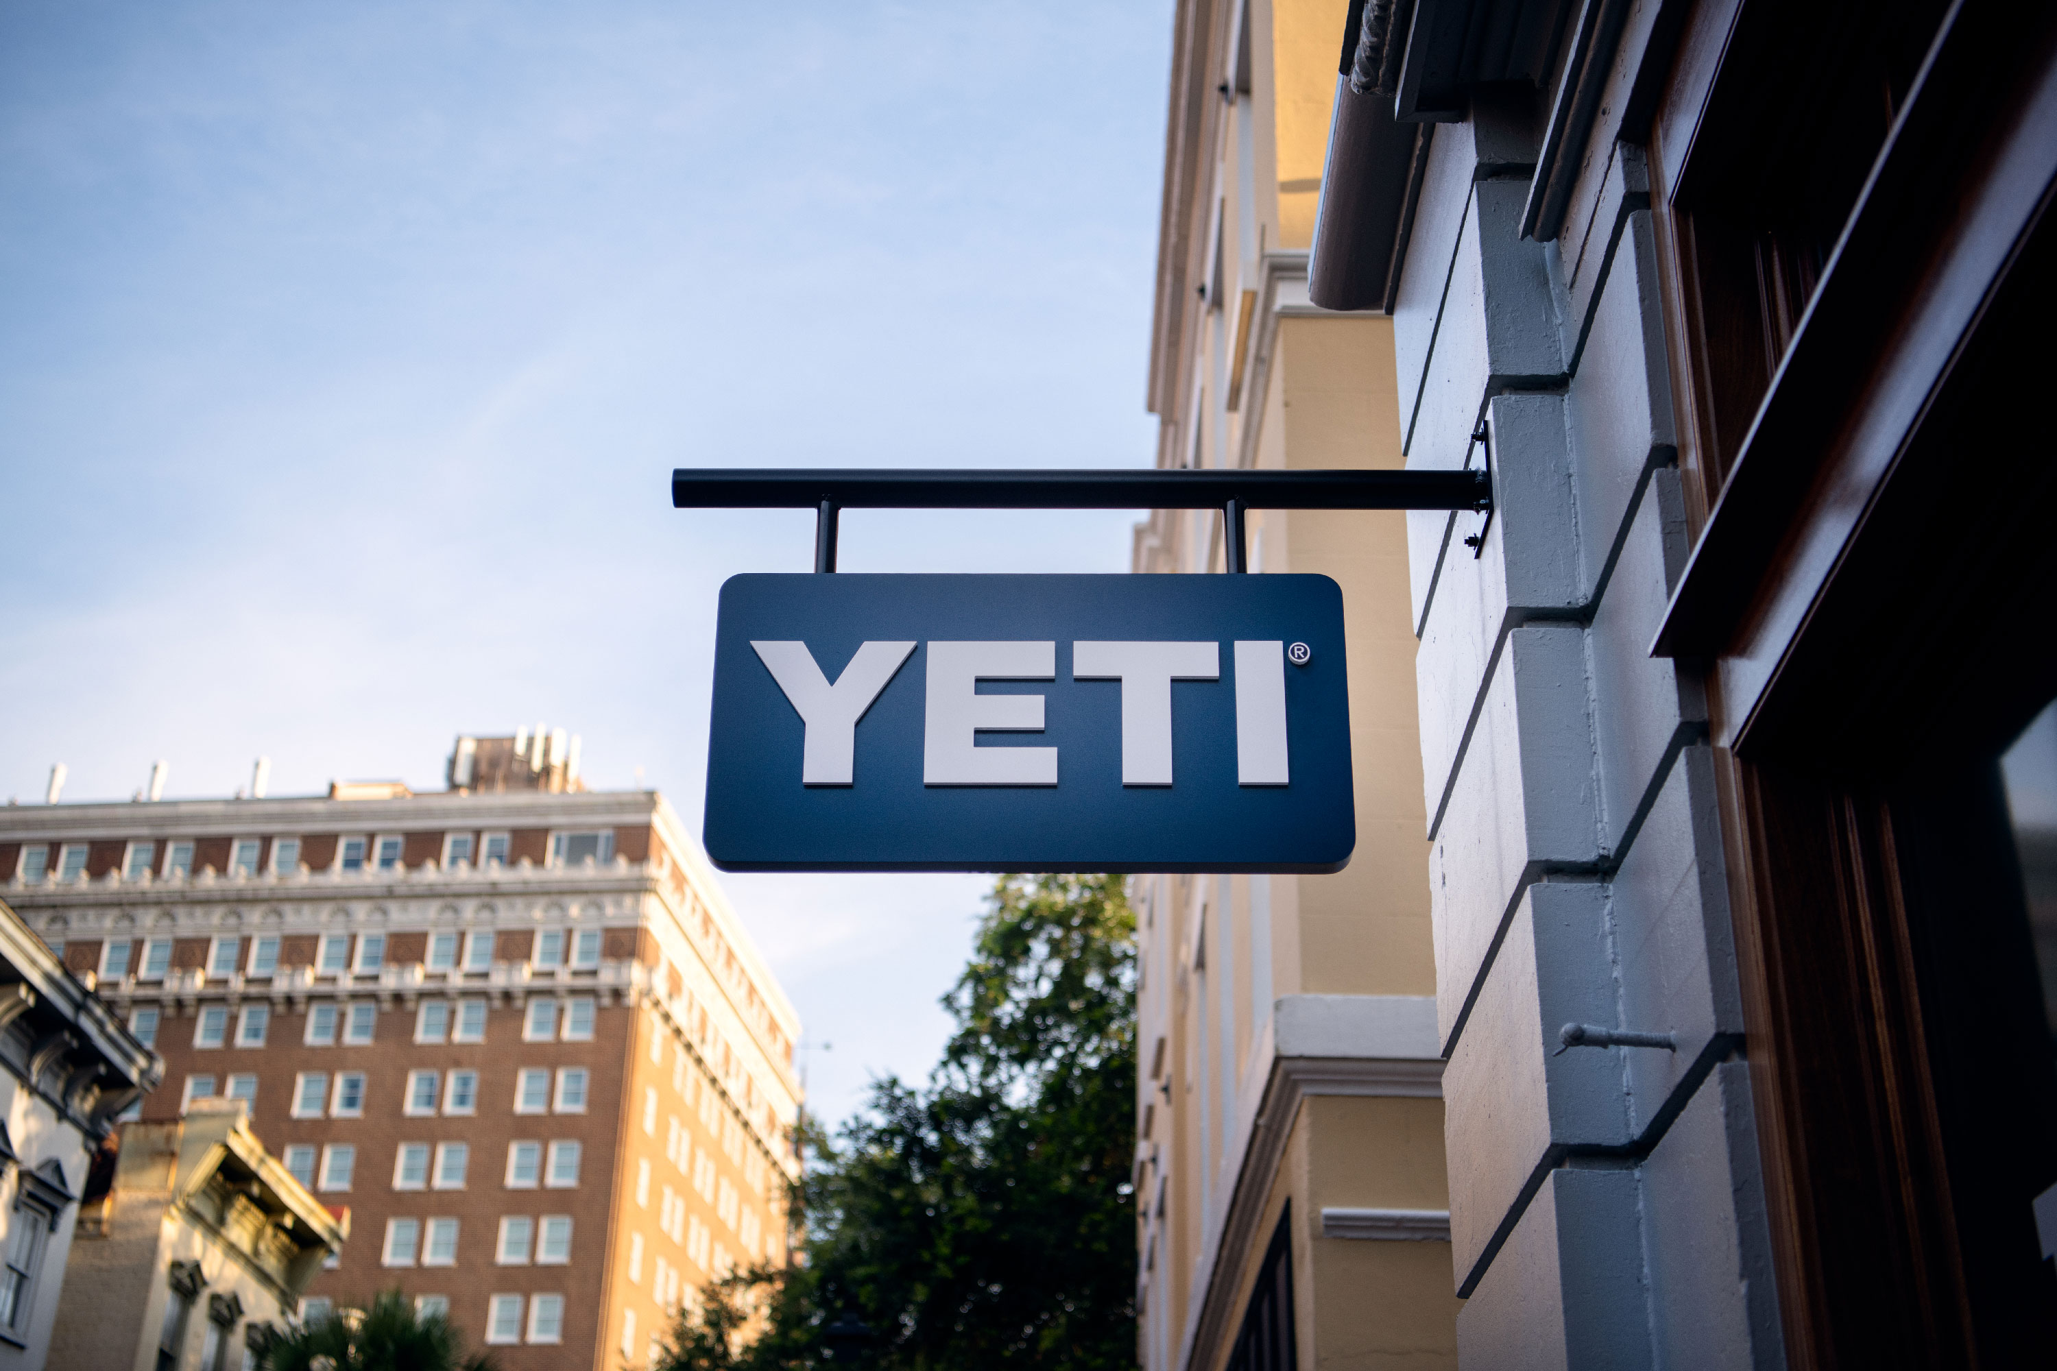
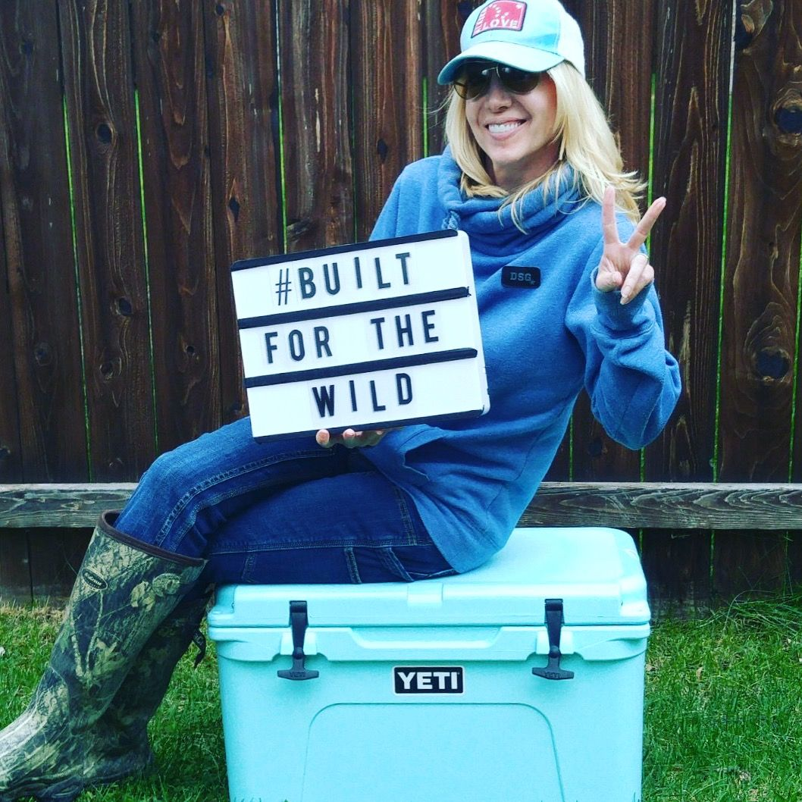
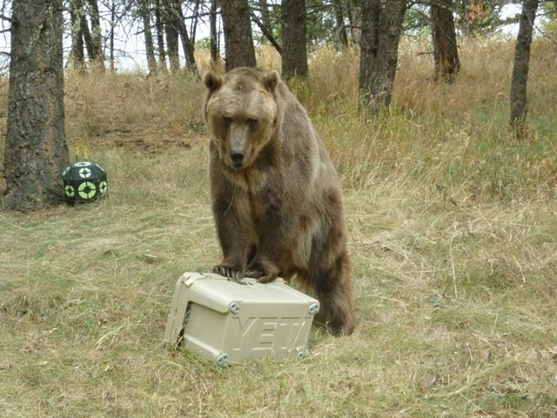
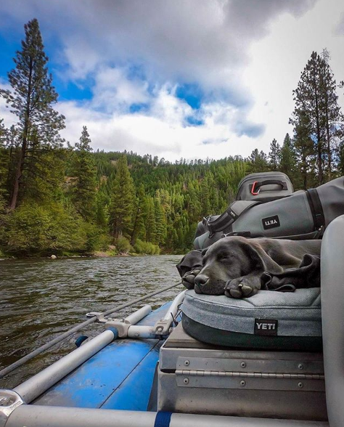

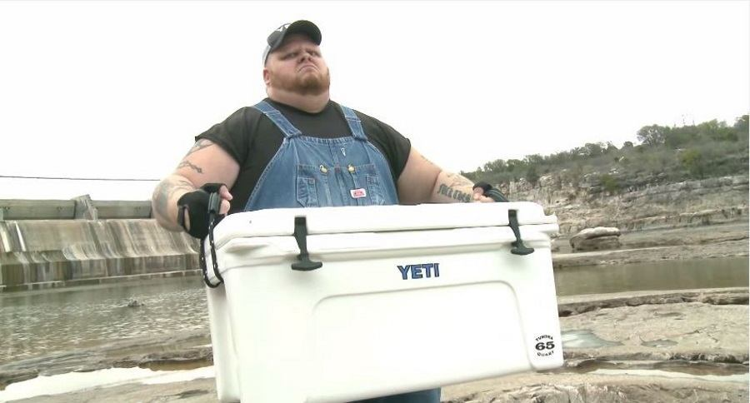
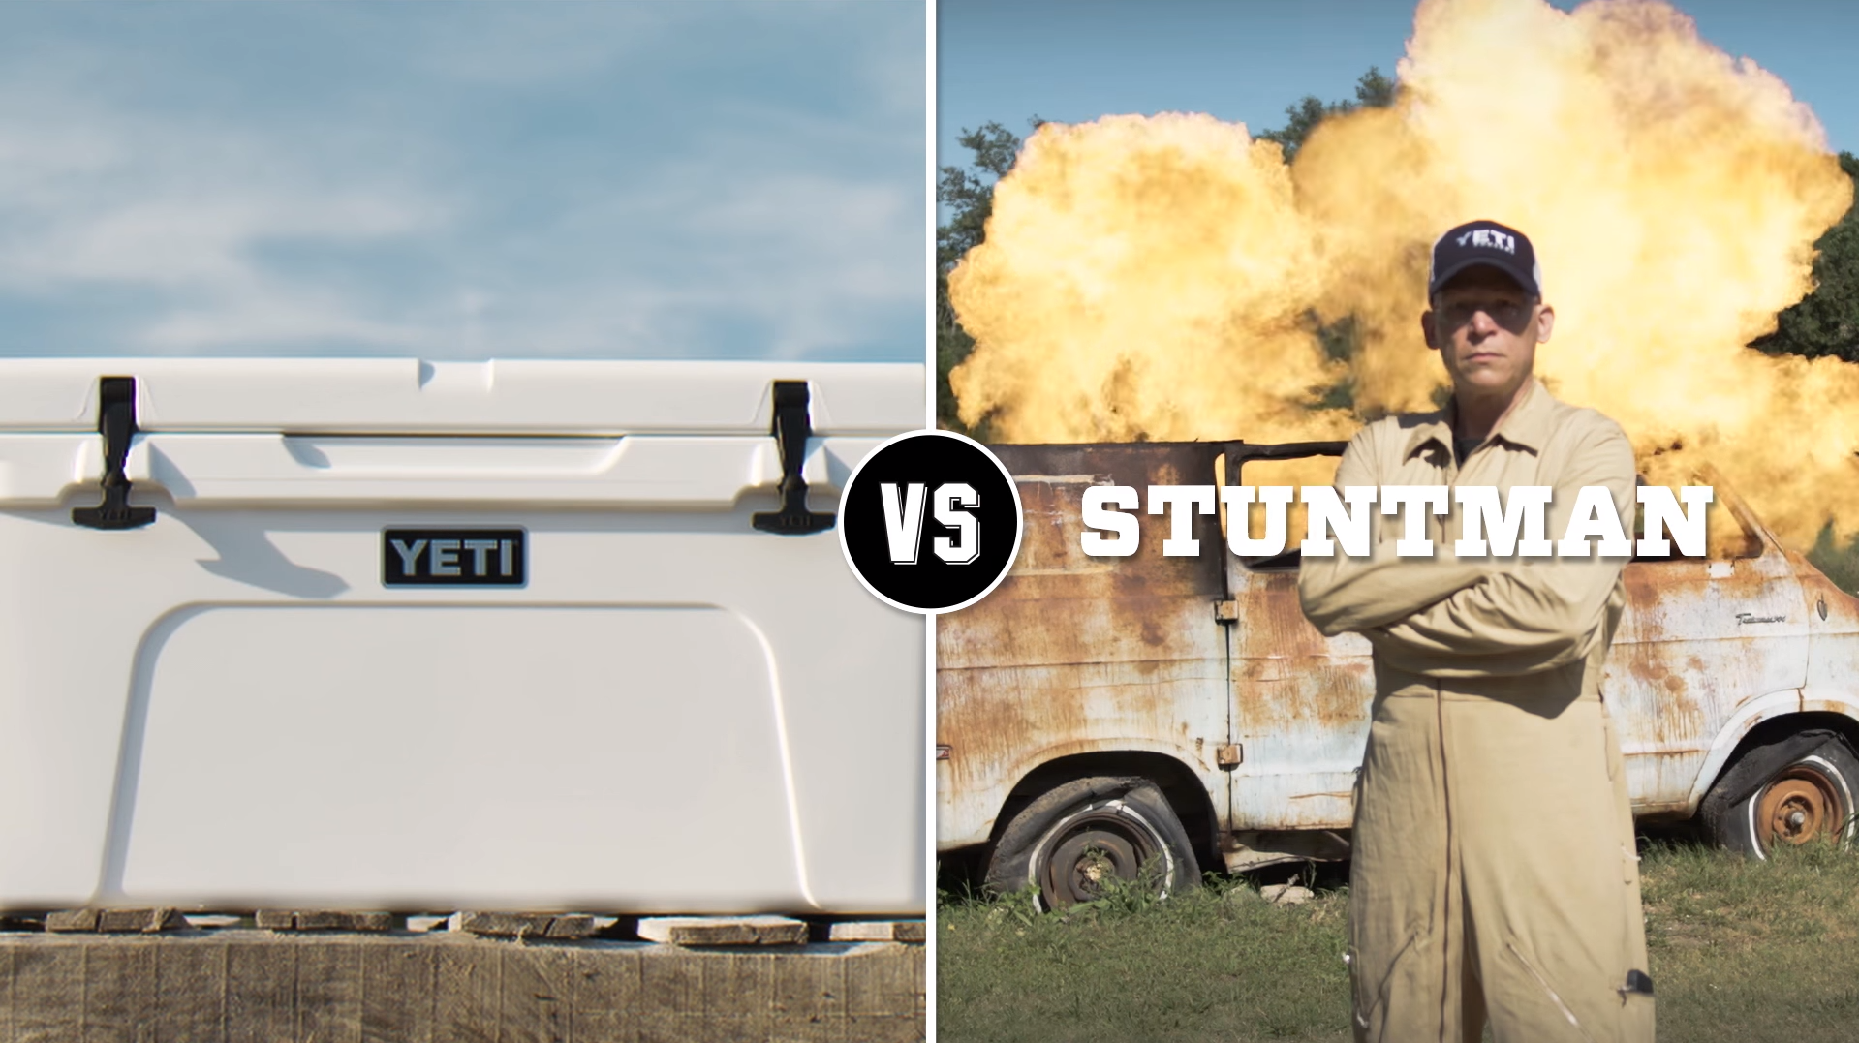


Slide 4
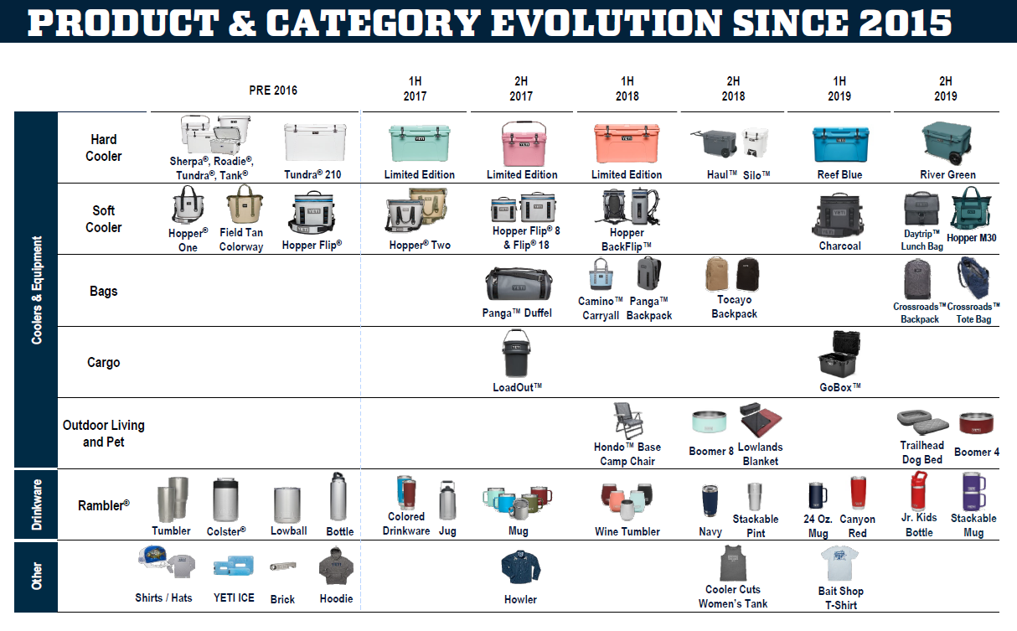


Slide 5

YETI & TABLEAU
Notes:
who our team is and how we started

Slide 6


ANALYTICS FOUNDATION
WHAT IS GOING TO HAPPEN
WHAT IS HAPPENING
WHAT HAPPENED
Notes:
Flip Text, boxes on right.
At YETI our goal is to predict the future, that’s everyone's goal.
When we started, realized needed a foundation
Knowing What Has Happened leads to
Knowing What’s Happening now which leads to
Knowing What’s Going to Happen.
Through this framework we had the question of “How do our sales channels compare geographically”
We have 3 main sales channels, DTC (Amazon and YETI.com), Wholesale, and our own Retail stores.
Each of these sales are tracked and maintained in different systems and so the relationships between them were unknown.
This is how we

Slide 7
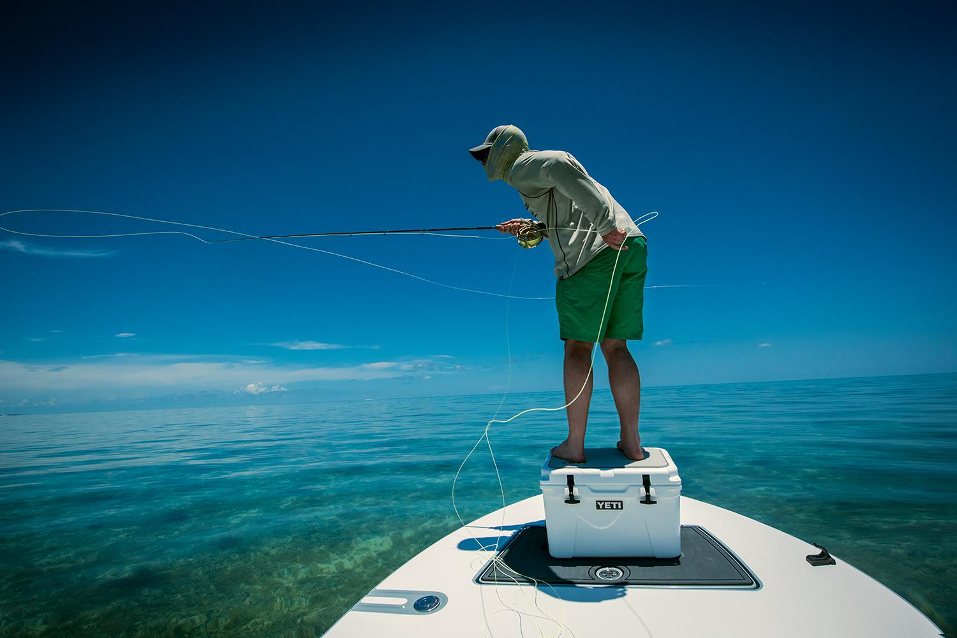
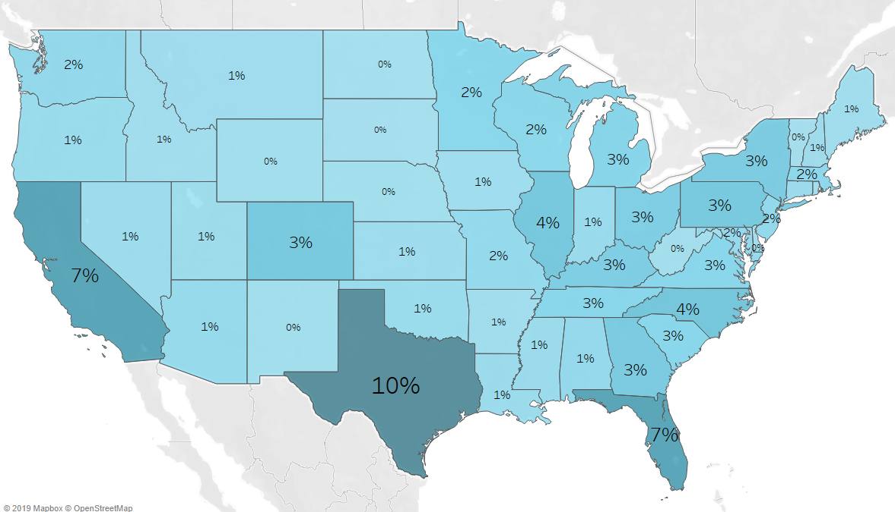
SAMPLED CUSTOMER
DISTRIBUTION FOR DTC
Notes:
A look at our % of sales across the country

Slide 8
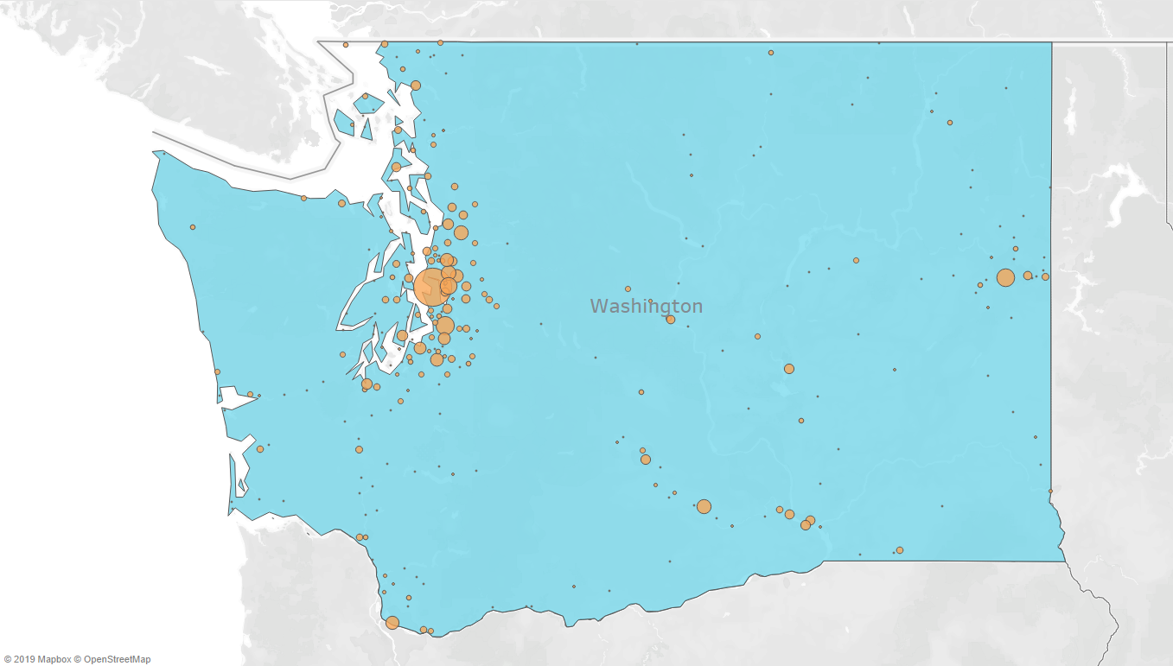
SAMPLED CUSTOMER
DISTRIBUTION FOR DTC
Notes:
A look at our % of sales across the country

Slide 9
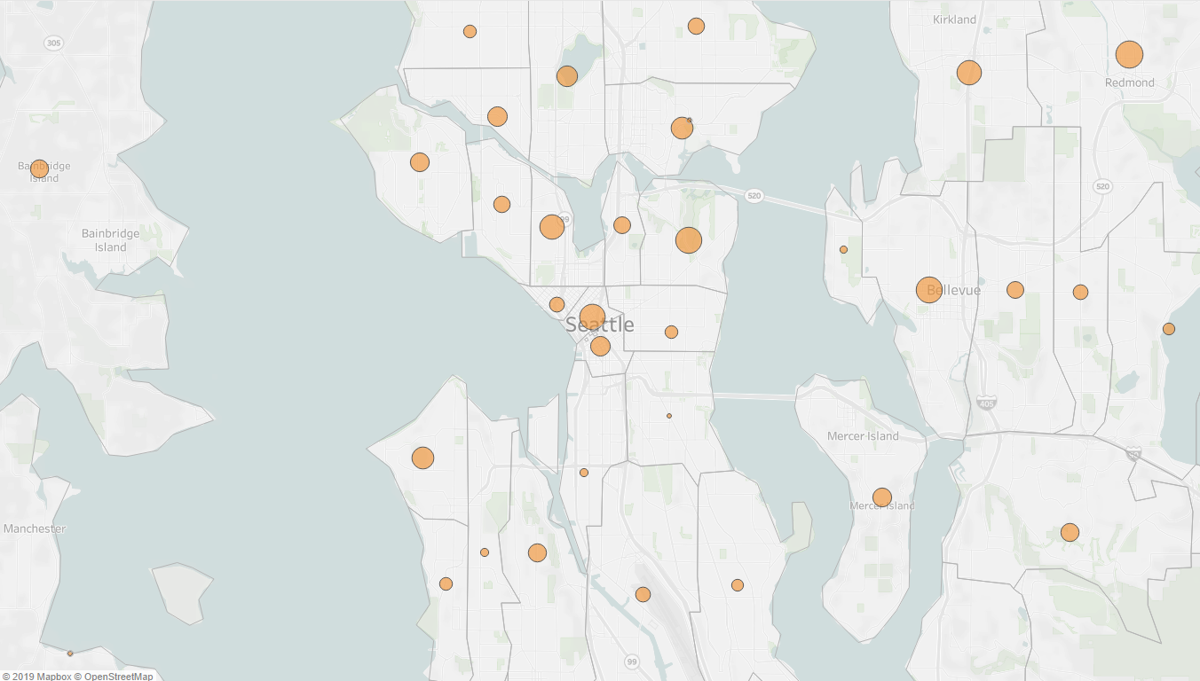
SAMPLED CUSTOMER
DISTRIBUTION FOR DTC
Notes:
A look at our % of sales across the country

Slide 10
DATA BLENDING
Source | Order Date | Product ID | Customer ID | ZIP
E-Comm (DTC) | Available | Available | Available | Available
Customized (DTC) | Available | Unavailable | Available | Available
3rd Party (DTC) | Available | Unavailable | Available | Available
YETI Retail (Wholesale) | Available | Available | Unavailable | Available
Wholesale | Unavailable | Unavailable | Unavailable | Partial
Notes:
How we filled in the gaps of our data.
Talk about 80/20 rule. Even if not 100% of the data is clean, we can still derive valuable insights.

Slide 11
DATA BLENDING
Source | Order Date | Product ID | Customer ID | ZIP
E-Comm (DTC) | Available | Available | Available | Available
Customized (DTC) | Available | Custom Hierarchy | Available | Available
3rd Party (DTC) | Available | Custom Mapping | Available | Available
YETI Retail (Wholesale) | Available | Available | Use Distinct Codes | Available
Wholesale | Purchase Date | Custom Hierarchy | Use Distinct Codes | Use Account Billing
Notes:
How we filled in the gaps of our data.
Talk about 80/20 rule. Even if not 100% of the data is clean, we can still derive valuable insights.

Slide 12

SAMPLED CUSTOMER
DISTRIBUTION FOR DTC
Notes:
A look at our % of sales across the country

Slide 13
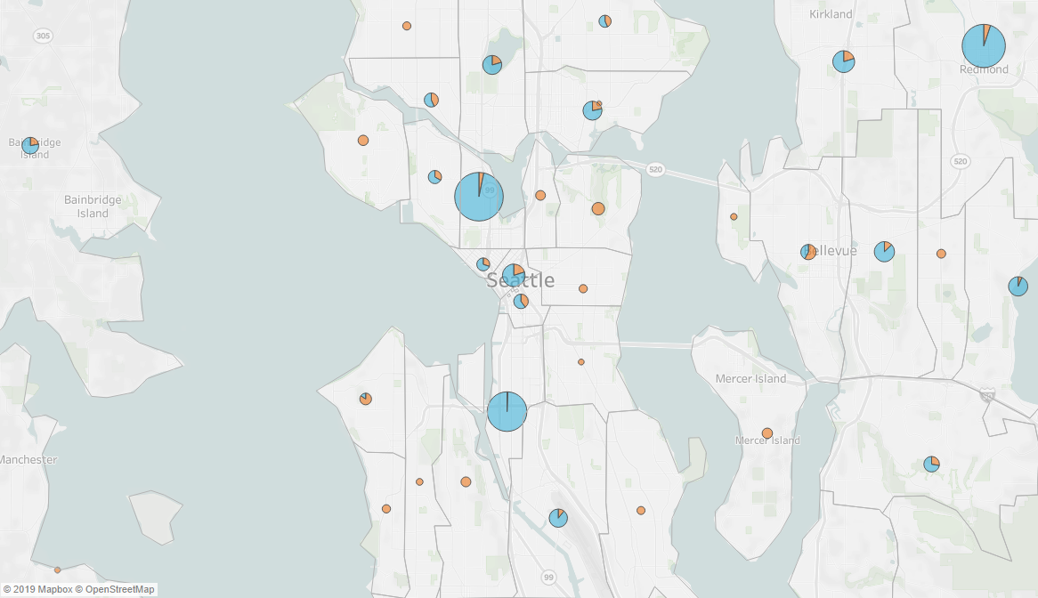
= DTC
= Wholesale
SAMPLED CUSTOMER
DISTRIBUTION FOR DTC AND WHOLESALE
Notes:
A look at our % of sales across the country

Slide 14
DATA SORTING
Source | Order ID | Address | City, ZIP | Geo Lat. / Long.
E-Comm (DTC) | Available | Available | Available | Unavailable
Customized (DTC) | Available | Available | Available | Unavailable
3rd Party (DTC) | Available | Partial | Available | Unavailable
YETI Retail (Wholesale) | Unavailable | Available | Available | Unavailable
Wholesale | Partial | Partial | Partial | Unavailable
Notes:
How we filled in the gaps of our data.
Talk about 80/20 rule. Even if not 100% of the data is clean, we can still derive valuable insights.

Slide 15
DATA SORTING
Source | Order ID | Address | City, ZIP | Geo Lat. / Long.
E-Comm (DTC) | Available | Available | Available | Unavailable
Customized (DTC) | Available | Available | Available | Unavailable
3rd Party (DTC) | Available | Follow up w/ supplier | Available | Unavailable
YETI Retail (Wholesale) | Use Purchase ID | Available | Available | Unavailable
Wholesale | Use Purchase ID | Use Account Billing | Use Account Billing | Unavailable
Notes:
How we filled in the gaps of our data.
Talk about 80/20 rule. Even if not 100% of the data is clean, we can still derive valuable insights.

Slide 16
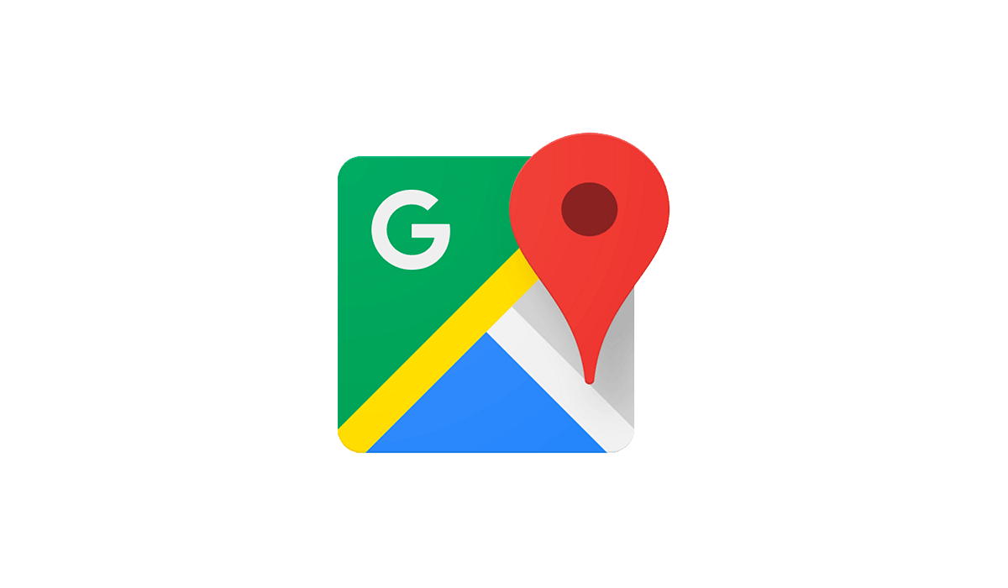
GOOGLE MAP API
ETL
Return
Notes:
- Persist addresses to Bigquery geocode.address_to_geocode table
- Publish addresses to geocode through ETL Job (Data cloud dataflow scheduled with Composer)
- Request geography data from Google Geocoding API for geocode-request per row
Publish Geocoding API response back to matching address row
Google Maps API will throttle automatically and helps prevent passing quota
Load Google Cloud Storage to Bigquery geocode.address_geocode table
76K records in 10 min w/ 60 nodes

Slide 17
DATA SORTING
Source | Order ID | Address | City, ZIP | Geo Lat. / Long.
E-Comm (DTC) | Available | Available | Available | Google API Lookup
Customized (DTC) | Available | Available | Available | Google API Lookup
3rd Party (DTC) | Available | Follow up w/ supplier | Available | Use ZIP Lat. / Long.
YETI Retail (Wholesale) | Use Purchase ID | Available | Available | Google API Lookup
Wholesale | Use Purchase ID | Use Account Billing | Use Account Billing | Google API Lookup
Notes:
How we filled in the gaps of our data.
Talk about 80/20 rule. Even if not 100% of the data is clean, we can still derive valuable insights.

Slide 18
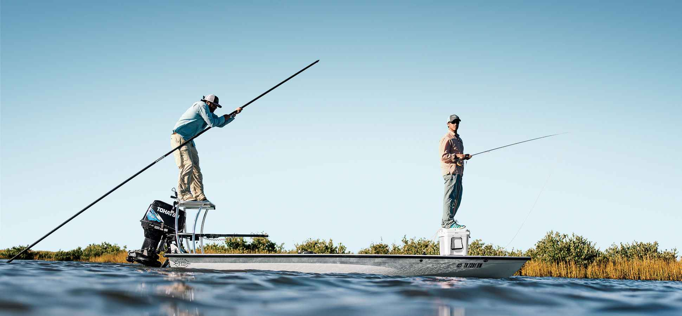
= DTC
= Wholesale
SAMPLED CUSTOMER
DISTRIBUTION FOR DTC AND WHOLESALE
Notes:
A look at our % of sales across the country

Slide 19
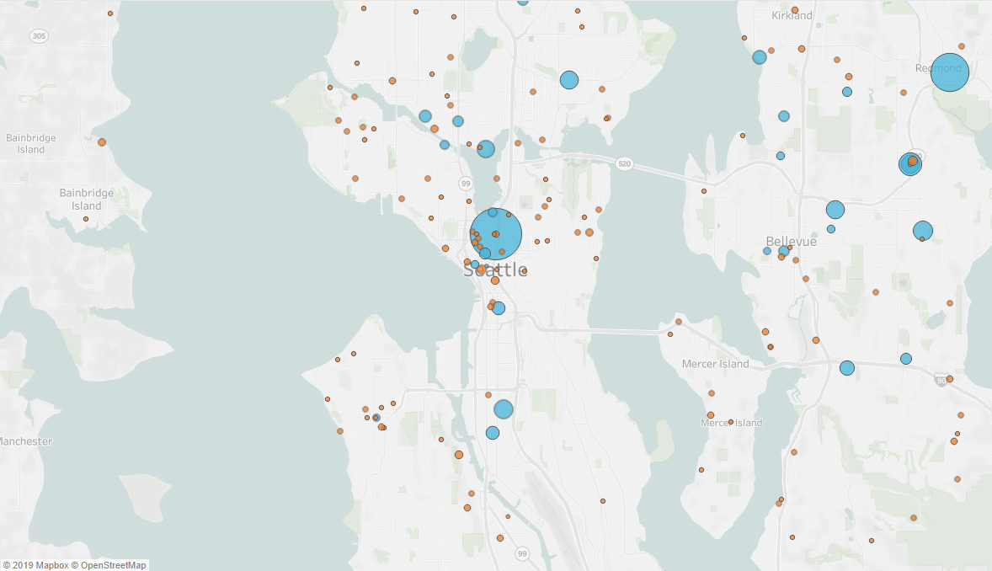
= DTC
= Wholesale
SAMPLED CUSTOMER
DISTRIBUTION FOR DTC AND WHOLESALE
Notes:
A look at our % of sales across the country

Slide 20
= DTC
= Wholesale
SAMPLED CUSTOMER
DISTRIBUTION FOR DTC AND WHOLESALE
Notes:
A look at our % of sales across the country

Slide 21
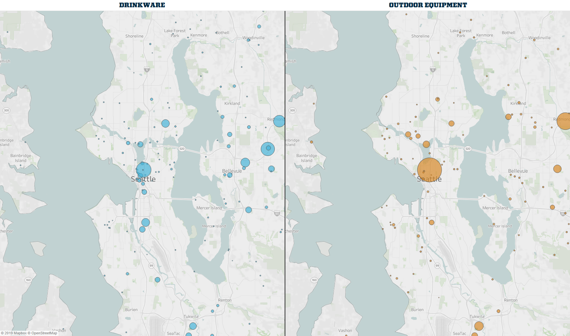
OUTDOOR EQUIPMENT
DRINKWARE
SAMPLED CUSTOMER
DISTRIBUTION FOR DTC AND WHOLESALE
Notes:
A look at our % of sales across the country

Slide 22
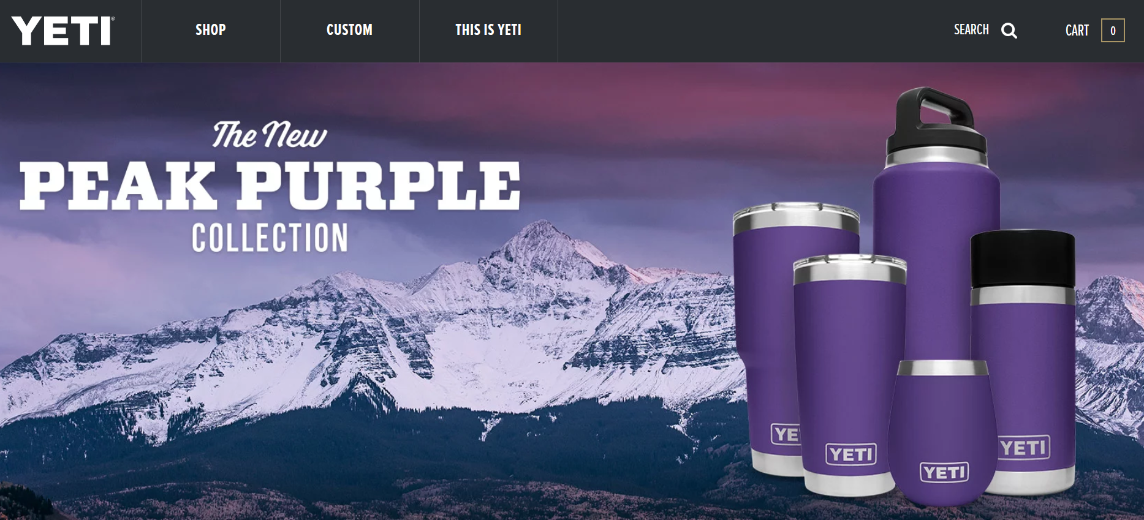
Peak Purple: A Case Study
PEAK PURPLE
New Popular Color
Visualization to Track Performances

Slide 23
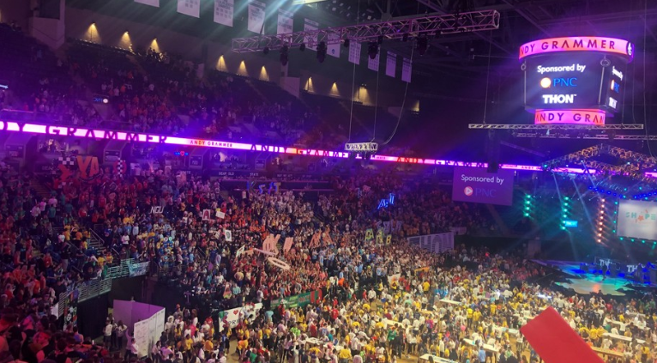

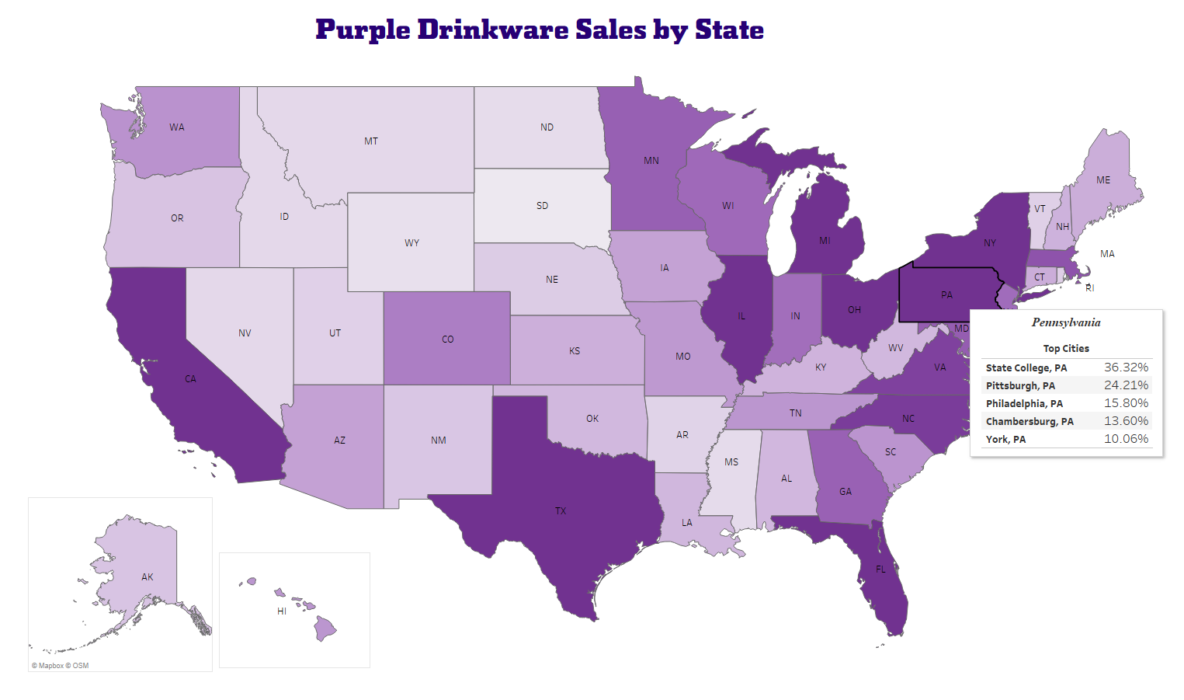

Diagnostic Analysis
Interesting insights leads to opportunities

Slide 24
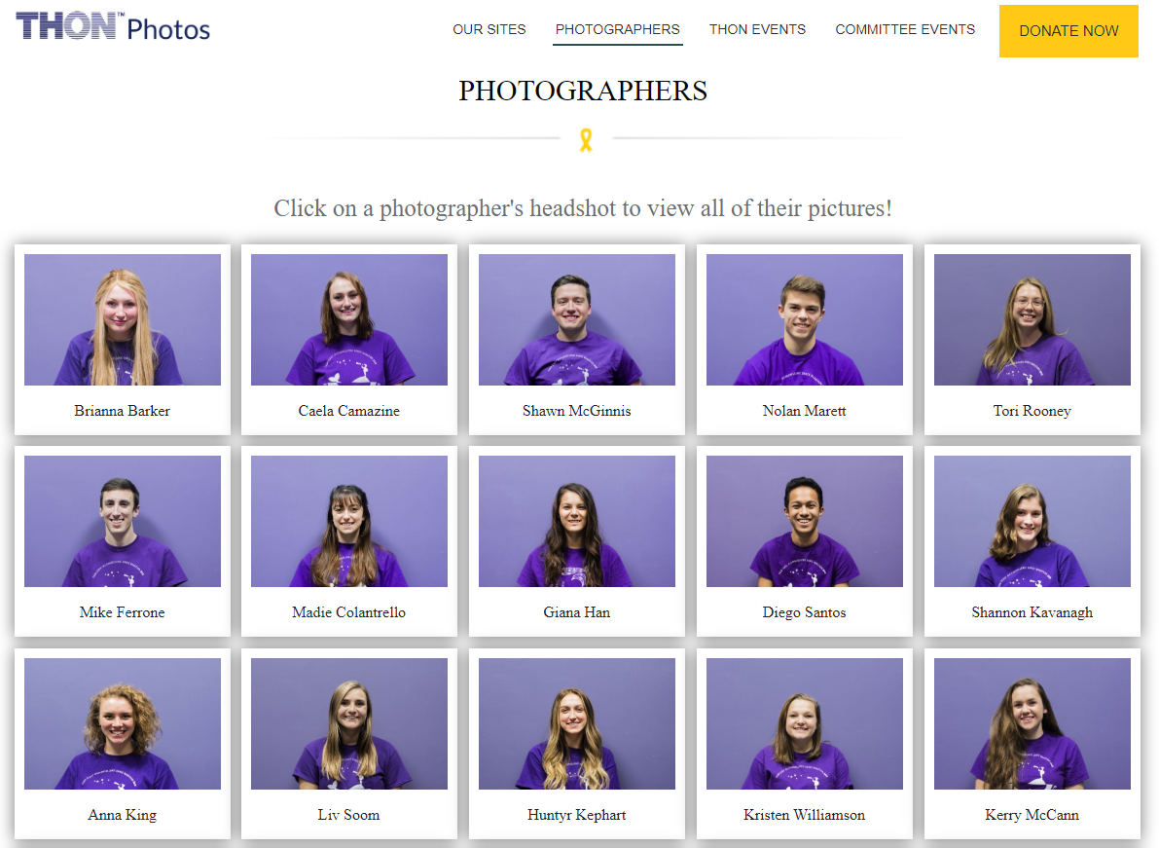

Slide 25
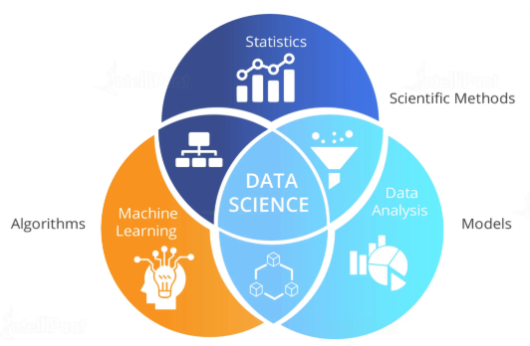
Building Predictive Capabilities
Advanced Algorithms and Data Science Models
Optimized Datawarehouse
From Customer Insights to Predictive Analysis
Tableau’s role in developing data culture and data-driven BI

Slide 26
KEY TAKEAWAYS

Slide 27

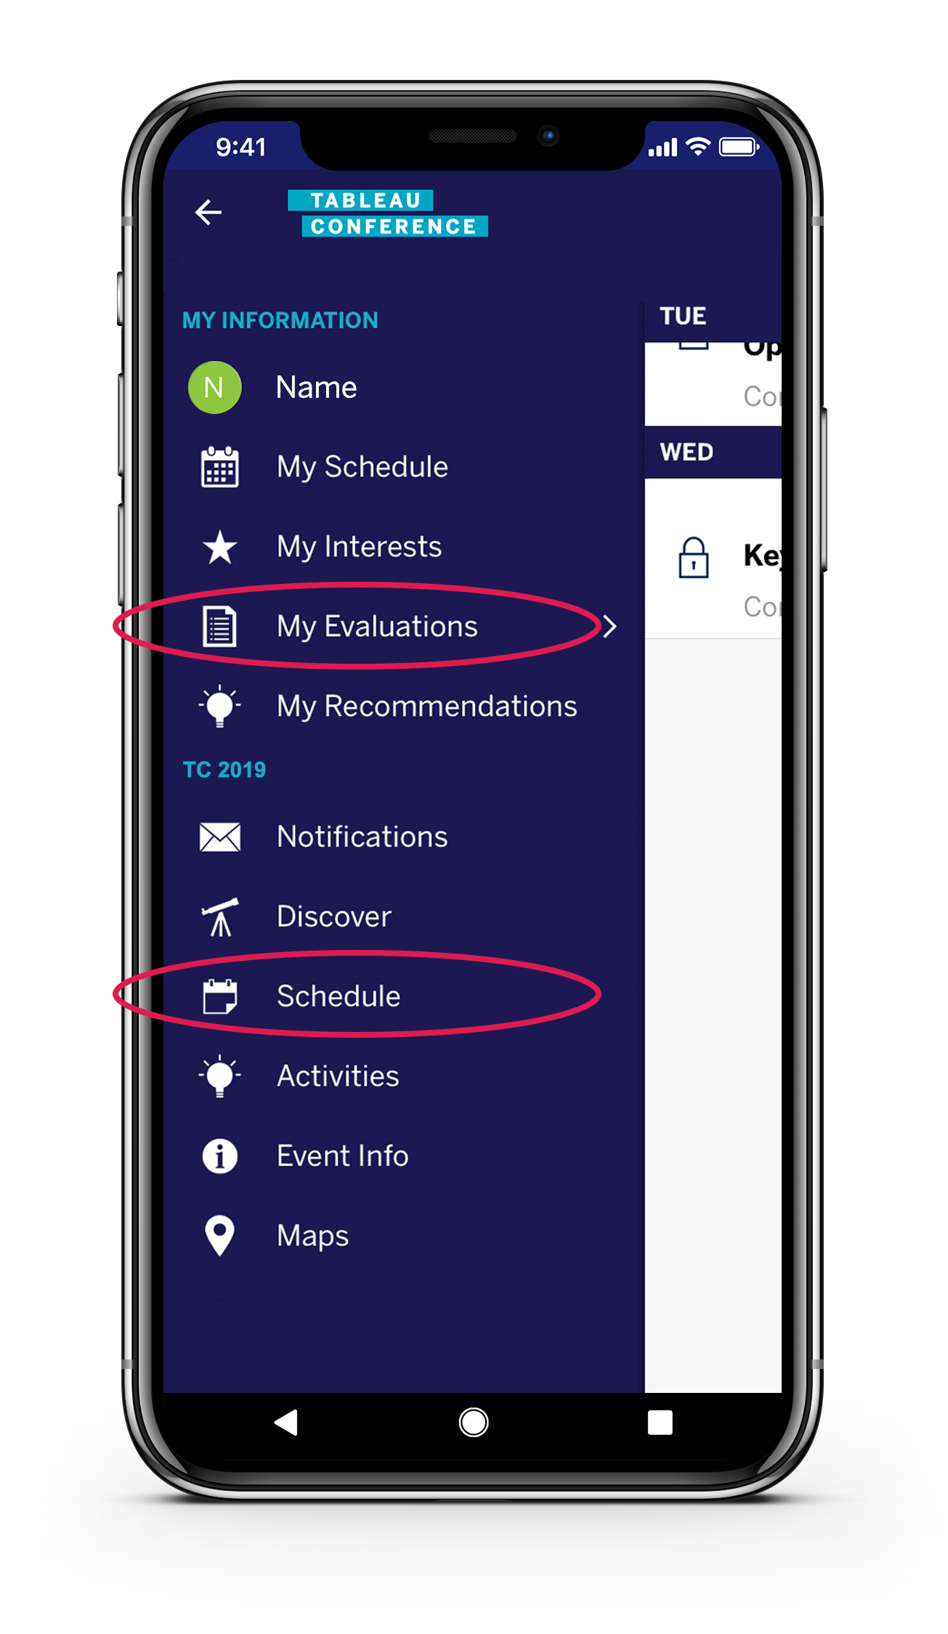
THANK YOU
PLEASE COMPLETE THE SESSION SURVEY IN THE MOBILE APP
VIEW ‘MY EVALUATIONS’ IN THE MENU OR FIND THE SESSION UNDER ‘SCHEDULE’
Notes:
A look at our % of sales across the country

Slide 28
THANK YOU

